Slide 1
IRREGULAR VERBS
By Pascal Blanchette, Anthony Chabot, Danaëlle Cottier and Samuel sternthal-ouimet

Slide 2
Instructions to the teacher
On each slide, click on the letter on the puck which represent your answer
To know what the answer is, click on the image of the goaltender
To change slide, click on “NEXT QUESTION” or on “TIME’S UP”

Slide 3
INSTRUCTIONS
You’re in a heated hockey match against the Windsor Spitfires. You’re losing 0-3. Your team, the UQAM Irregulars, must score 4 goals to complete the comeback and win.
Find the correct irregular verb in each sentence to score goals.

Slide 4
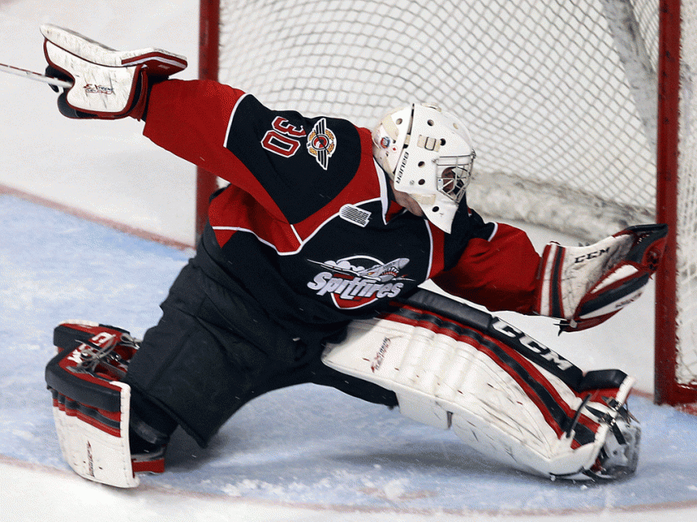
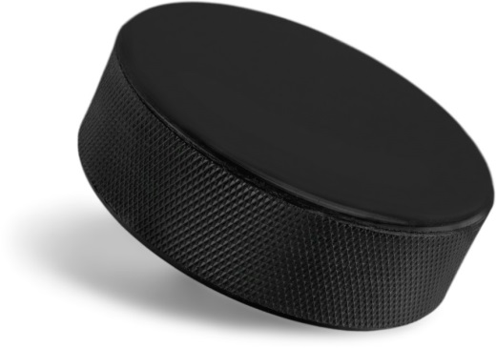
A
B
NEXT QUESTION
C
D
SAVE !
SAVE !
GOAL!
SAVE !
A. SPEND
B. SPENT
C. SPENDED
D. SPADE
RIGHT ANSWER:
SPENT
The Canadiens (TO SPEND) the entire powerplay in the offensive zone. They are on fire tonight!
To know that the right answer is, click on the image of the goaltender!

Slide 5
A
B
NEXT QUESTION
C
D
SAVE !
SAVE !
GOAL!
SAVE !
A. DRINK
B. DRUNK
C. DRANK
D. DRINKED
RIGHT ANSWER:
DRANK
During the commercial break, Carey Price stayed next to his net because he (TO DRINK) water from his bottle.
To know that the right answer is, click on the image of the goaltender!

Slide 6
A
B
NEXT QUESTION
C
D
SAVE !
SAVE !
GOAL!
SAVE !
A. SHOOT
B. SHOOTED
C. SHUT
D. SHOT
Sidney Crosby entered the offensive zone. The puck was on his stick and the goaltender didn’t see where the puck was. Sidney (TO SHOOT) on the net.
To know that the right answer is, click on the image of the goaltender!
RIGHT ANSWER:
SHOT

Slide 7
A
B
NEXT QUESTION
C
D
SAVE !
SAVE !
GOAL!
SAVE !
A. FELL
B. FALL
C. FALLEN
D. FELT
Patrick Kane was trying to get to the offensive zone, but he lost control of the puck and (TO FALL) on the ice.
RIGHT ANSWER:
FELL
To know that the right answer is, click on the image of the goaltender!

Slide 8
A
B
TIME’S UP
C
D
SAVE !
SAVE !
GOAL!
SAVE !
RIGHT ANSWER:
HAS BROKEN
(BROKE would also work)
A. BROKED
B. HAS BROKEN
C. HAD BROKEN
D. BREAK
After 58 minutes, the game is still a 0-0 tie. After a lucky bounce, Nashville Predators’ superstar PK Subban scores on his friend Tuukka Rask. He (TO BREAK) the tie.
To know that the right answer is, click on the image of the goaltender!

Slide 9
Let’s count the goals
Did you win?
Did you lose?

Slide 10
You could not complete the comeback

Slide 11
Congratulations!

